Slide 1
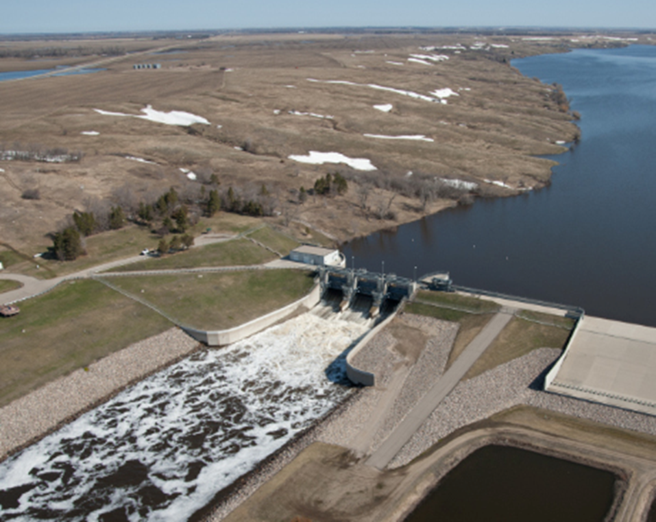
Baldhill dam and Lake Ashtabula Water Control Manual Update
Public Open House
11 October 2023

Slide 2
We are here to:
share about the Corps effort to update the Baldhill Dam Water Control Manual
AND
listen to your ideas for Baldhill operations
This presentation is also streaming on YouTube
Notes:
Sierra The presentation can also be viewed after the fact on our website, so please feel free to share with others who didn’t make it today.

Slide 3
To ensure this happens we will have a:
15 Minute Presentation
Public Input
Open House
Notes:
Sierra

Slide 4
Meeting Ground Rules
During the Corps presentation please:
Keep questions until end
During the public input time:
Keep remarks brief to allow enough time for all
There will be time for additional comments or answering your questions during the open house
During the open house:
Corps staff available to answer questions
Share comments in writing via comment sheet
Email comments to LakeAshtabula@usace.army.mil
Notes:
Sierra
Corps Employees:
Respond respectfully to all questions
Follow up on questions we cannot answer at this time
Help the public understand project constraints and opportunities
We request that participants:
Respectfully ask questions and share comments
Allow time for all to ask questions and share input
Help the Corps understand opportunities and concerns

Slide 5
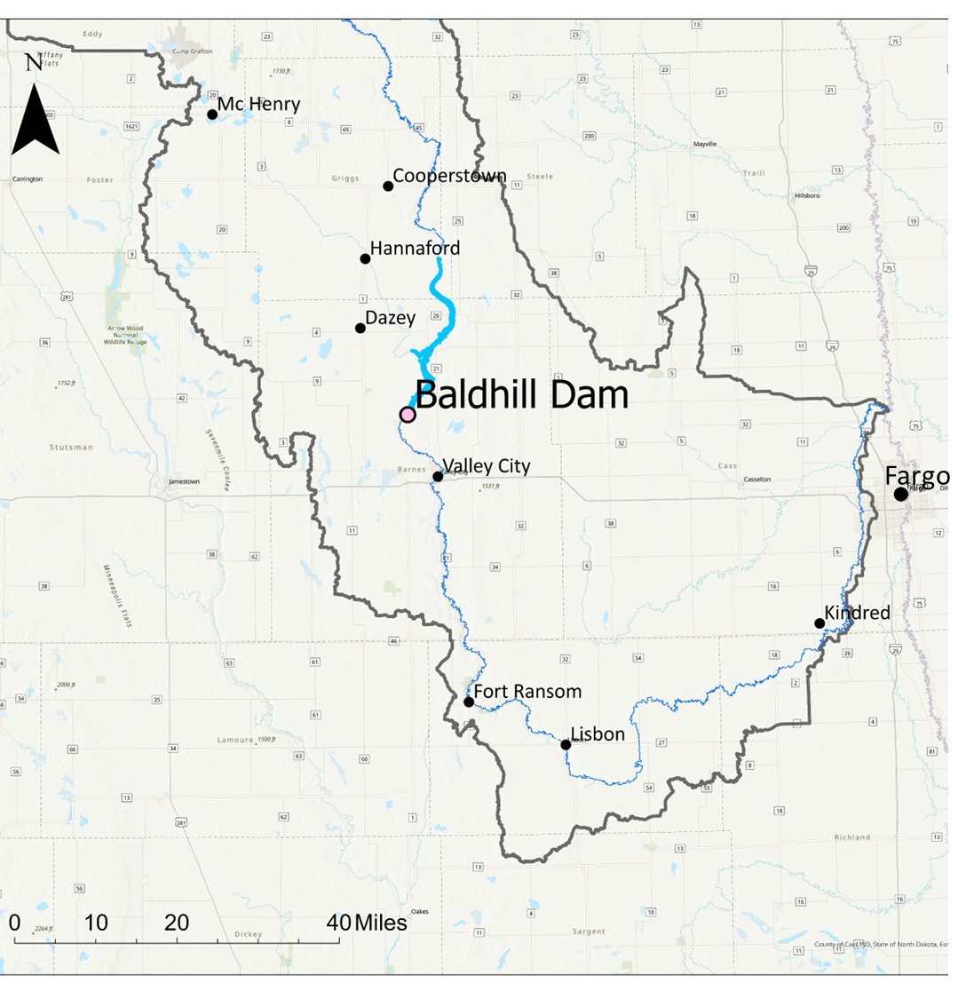
Baldhill Dam/ Lake Ashtabula project
Main Purposes
Flood Control and Water Supply
Secondary Purposes
Recreation, Fish and Wildlife, Water Quality
Notes:
Michael - Start presenting
Project has 3 components
White Rock Dam/Mud Lake
Reservation Dam/Lake Traverse
Browns Valley Dike
Browns Valley Dike in place to prevent Lake Traverse from spilling over continental divide into Big Stone Lake
Completed in 1942
The two reservoirs work in conjunction with Orwell Dam to provide flood control at Wahpeton/Breckenridge.
Stage at Wahpeton, ND gage

Slide 6
What is a Water Control Manual?
The water control manual dictates how the Corps manages the water at the project under various conditions
→ Corps staff cannot deviate from the manual unless it is an emergency or higher-level approvals have been received
Notes:
A Water Control Manual is important because it provides operational instructions to personnel involved in managing the reservoir. A Water Control Manual is especially important because it provides clear instructions to be followed during emergency situations. Since the manuals contain records of institutional knowledge, they also prevent the loss of operational expertise. They also ensure unbiased operations and that mission priorities are transparent to the public.

Slide 7
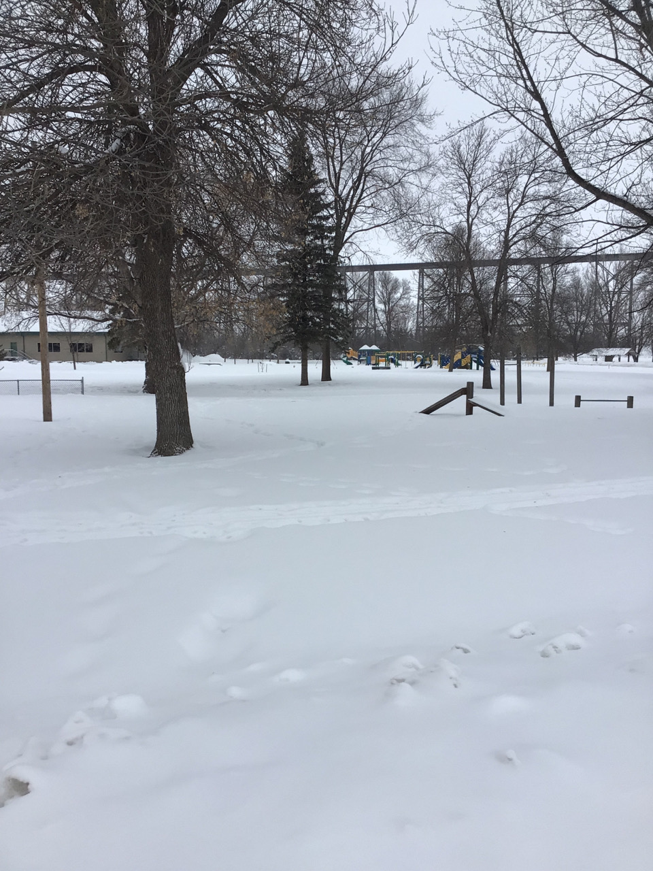
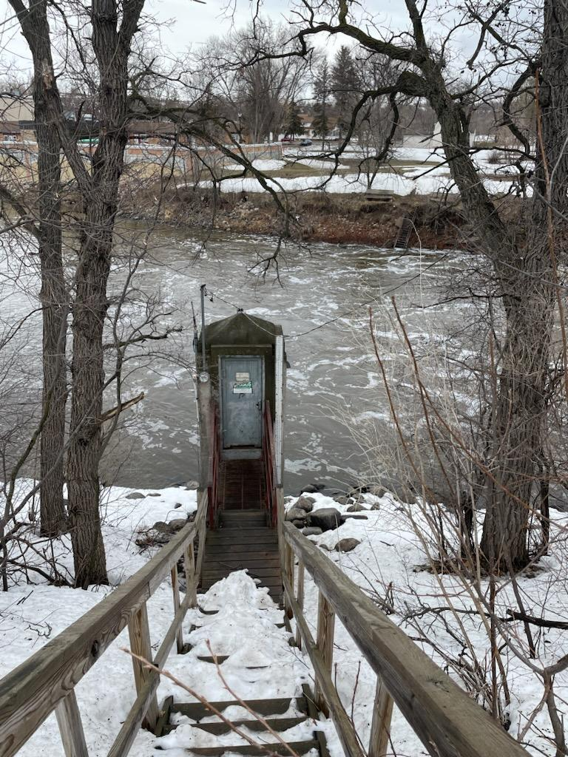
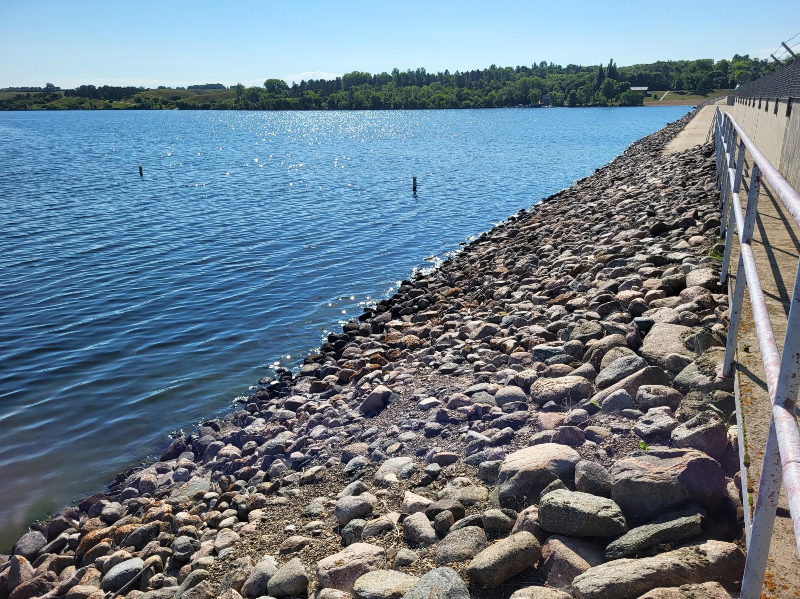
Baldhill Dam General Operation: Current Manual
Summer
Maintain steady pool level
Fall/Winter
Lake Ashtabula is lowered for flood storage to a level dependent on snowpack.
Spring
Lake Ashtabula is managed to minimize downstream flooding and raised to summer level.
Valley City 2/24/23
USGS Gage at Valley City 4/14/23
Pool at summer conservation level from the dam, 8/2/23
Notes:
The overall plan calls for maintaining a pool for water supply and providing flood storage in the spring. Water quality is poor in the reservoirs, so the main purpose is flood control. Generally, the Lake Traverse and Mud Lake pools are maintained near their conservation pool levels except for flood control.
The pool may be lowered in the spring depending on snowpack conditions in the Otter Tail and Bois De Sioux Watersheds. The reservoirs along with Orwell Dam are primarily operated based on a stage at Wahpeton, ND. A Category I stage corresponds to 10 ft at Wahpeton, and a Category II stage corresponds 12 ft at Wahpeton. Once the stage at Wahpeton exceeds a Cat. I or Cat. II White Rock Dam is closed until Lake Traverse pool reaches top of flood control (in these conditions the pools have merged) or the stage at Wahpeton drops below the threshold. If the pool reaches top of flood control, discharges near the inflow rate are released.

Slide 8
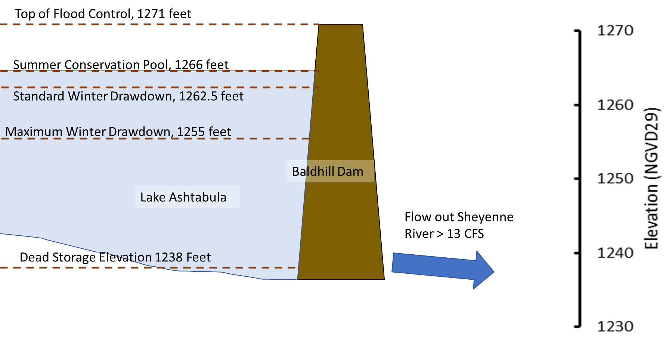
Normal operations- Current Manual
Notes:
How operations change with seasons/events
Generally, a conservation pool is maintained at both reservoirs….Lake Traverse targets 976.8’ MSL 1912 after spring runoff. This is 0.8’ above the Conservation Level of 976’. This cushion is built in to help offset evaporation during dry years when there is no inflow.
Mud Lake maintains a conservation pool of 972’ during normal operations.
A maximum discharge from White Rock dam is limited to 1,100 cfs while pools are at conservation level. There is no minimum discharge (channel can and does go dry).

Slide 9
Devils Lake Outlet
Devils Lake outlets into the Sheyenne River upstream of Baldhill Dam via two constructed outlets, constructed in 2005 and 2012
Total capacity 600 CFS
Not controlled by USACE
Average summer flow into and out of Lake Ashtabula is much higher than before 2005.
Notes:
Pool is currently in band.
Drawdown in March.
CAT I: SWE in basin < 3 inches, no drawdown.
CAT II: SWE in basin > 3 inches, drawdown pool to 1050 – 1060 feet.

Slide 10
RED RIVER VALLEY WATER SUPPLY Project
Overview:
Non-federal project
A proposed project to provide water to the cities of Eastern North Dakota and Western Minnesota during periods of extreme drought.
Project plans to treat and convey water from the Missouri River Basin to the Sheyenne River.
Impacts to Baldhill Dam Operations:
Water would be pumped into the Sheyenne River above Lake Ashtabula.
When operational, this project would require outflow from Baldhill Dam to meet water supply needs downstream.
Increased outflow from the dam would be partially or fully offset by water inputs from the project.
Notes:
Pool is currently in band.
Drawdown in March.
CAT I: SWE in basin < 3 inches, no drawdown.
CAT II: SWE in basin > 3 inches, drawdown pool to 1050 – 1060 feet.

Slide 11
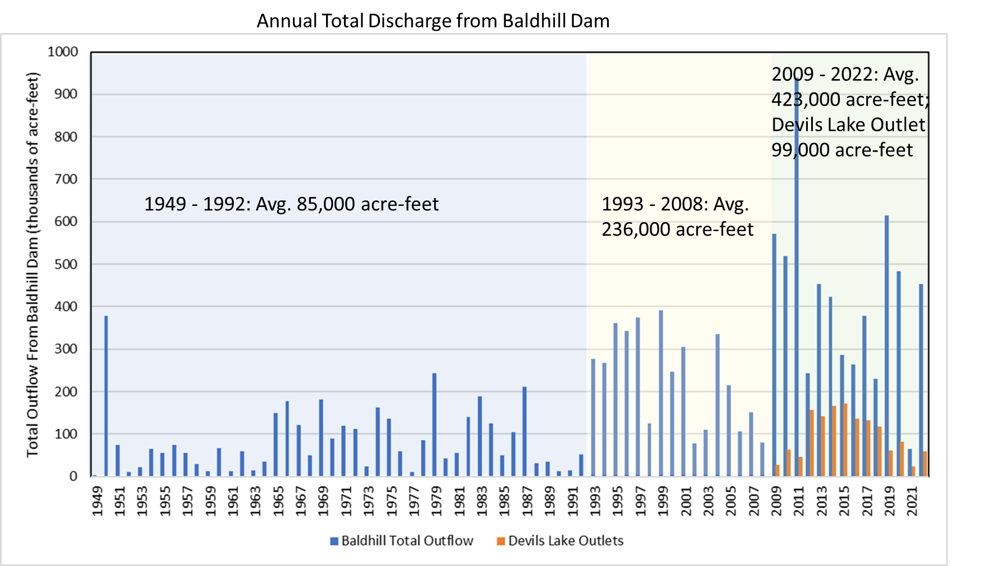
What has changed in Recent Years?
Last WCM Update 2013
Notes:
Major Changes since last WCM Update 1994
New Flood Control Projects
Wahpeton, ND and Breckenridge, MN Levee Upgrades
Breckenridge Diversion
Reservation Dam Outlet Works Upgrade
Hydrology
Recreation Infrastructure
???
Additional Considerations for next WCM
Sedimentation
Mud Lake Drawdown??
???

Slide 12
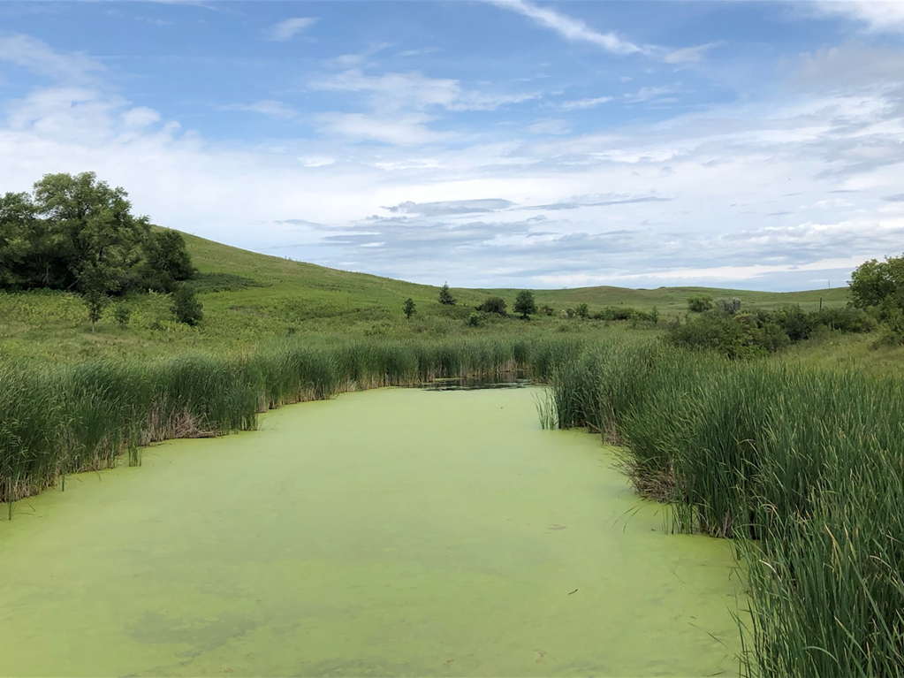
Lake Ashtabula – Positives
Fish and wildlife
Productive sport fishery
Waterfowl
Migratory birds
Mississippi Flyway
Vegetation
Shrubs and forests
Wetlands
114 Acres of emergent wetlands
Notes:
Amanda
Impairments
Though it is at a very low elevation, the Laurentian Divide runs through Browns Valley between Lake Traverse and Lake Big Stone. Because of its position on the divide, water from Lake Traverse will end up in Hudson Bay

Slide 13
Lake Ashtabula Environment – Impairments
Poor water quality in both lakes
High nutrient levels
Farm field run-off
Algae blooms
Fish kills
Erosion
Sedimentation
Loss of aquatic vegetation
Turbidity
Lake level fluctuation
Bois de Sioux River
Notes:
Amanda
Impairments
Though it is at a very low elevation, the Laurentian Divide runs through Browns Valley between Lake Traverse and Lake Big Stone. Because of its position on the divide, water from Lake Traverse will end up in Hudson Bay

Slide 14
Endangered Species
Species | Status | Group
Northern Long-eared Bat | Endangered | Mammal
Dakota Skipper | Threatened | Insect
Monarch Butterfly | Candidate | Insect
USFWS
USFWS
USFWS
USFWS
Notes:
Amanda

Slide 15
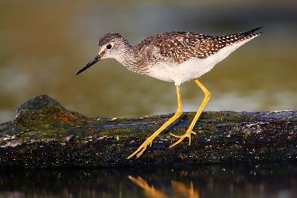
Migratory Bird Species
USFWS
Common Name | Breeding Period
American Golden-plover | Breeds elsewhere
Bald eagle | Dec 1 - Aug 31
Black tern | May 15 - Aug 20
Bobolink | May 20 - July 31
Clark's Grebe | Jun 1 to Aug 31
Franklin's Gull | May 1 to Jul 31
Golden Eagle | Jan 1 to Aug 31
Lesser yellowlegs | Breeds elsewhere
Long-eared Owl | Mar 1 to Jul 15
Marbled Godwit | May 1 to Jul 31
Western grebe | Jun 1 - Aug 31
Willet | Apr 20 - Aug 5
USFWS
USFWS
Notes:
Amanda

Slide 16
Timeline for Water Control Manual Update
NOW
Part 1: Sep 8 – Nov 10, 2023
Collect and organize public comments on areas for possible improvement
Part 1: Nov 2023 – Apr 2024
Prepare modeling and performance indicators
Study alternatives based on feedback on areas for possible improvement
Part 1: Apr – Jun 2024
Second set of public meetings and comment period on alternative operating plans
Part 1: Jun – Sep 2024
Study alternatives based on feedback on 1st round of results
Part 2 of update (to be scheduled, pending funding)
Final set public meetings and comment period on recommended plan
Approval of plan and approval of updated Water Control Manual
Opportunities for public input
Notes:
Sierra
We don’t know when the funding will come, but we need to be ready for parts 2&3 when we have money. Money is allocated from Corps HQ.

Slide 17
How to Share input
An updated water control manual could address:
Share comments by 10 Nov 2023:
1. Written in open house session
2. Electronically to LakeAshtabula@usace.army.mil
Lake sedimentation
Changes to normal pool elevation (higher or lower)
Changes to outflow from dam
Modifications for environmental benefits
Other ideas?
Notes:
Sierra

Slide 18
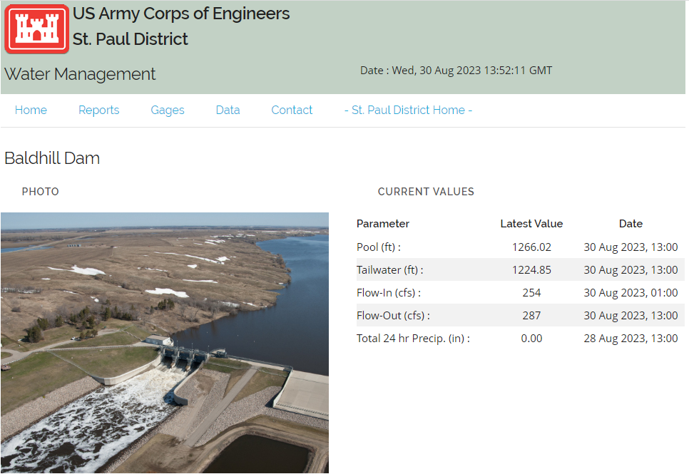
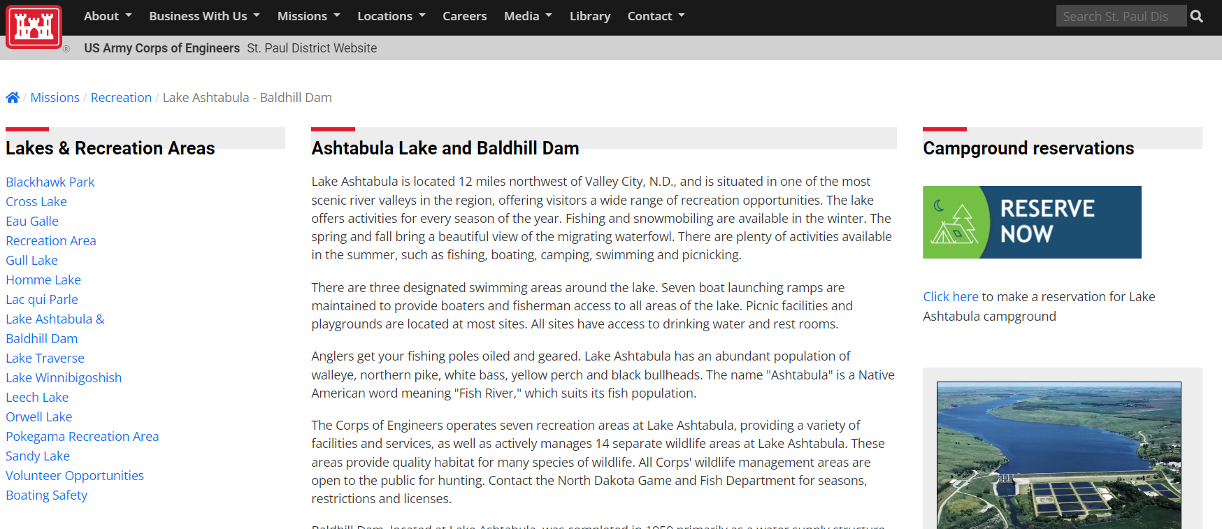
Finding Additional Info
GENERAL LAKE ASHTABULA INFOMATION:
UPDATED GAGE DATA:
www.mvp.usace.army.mil/Missions/Recreation/Lake-Ashtabula-Baldhill-Dam/
www.mvp-wc.usace.army.mil
Water Control Manual available on national website: water.usace.army.mil

Slide 19
Public Input
Keep remarks brief to allow enough time for all
There will be time for additional comments or answering your questions during the open house
Open House
Corps employees answer questions one on one
Public has opportunity to submit written public comments in person
Notes:
Sierra

Slide 20
Public Input
It’s time to listen to your ideas for Baldhill Dam operations
What issues or resources should be studied?
What do you want to stay the same or change?
What potential water management options for Baldhill Dam should be considered?
Notes:
Sierra
about 30 mins for public input
Corps staff must go to the lectern to answer question. Sierra will have portable mic for the public.
Questions about CURRENT conditions we can give answers to, but comments/ideas about FUTURE should be submitted as a question
The Corps teams will be meeting to discuss public, agency, and tribal ideas next month. All comments welcome

Slide 21
Thank you for your participation
Open House begins now
Notes:
Jill

Slide 22
Who is all here?
Scott Tichy
ND Section Supervisor
Michael Swenson
Water management hydrologist
Liz Nelsen
Supervisory engineer
Amanda Goldstein
Biologist
Katie Opsahl
Water resources planner
Elizabeth Stoeckmann
Public affairs officer
Sierra Keenan
Meeting facilitator
Notes:
END FACEBOOK FEED

Slide 23
Current Backup slides

Slide 24
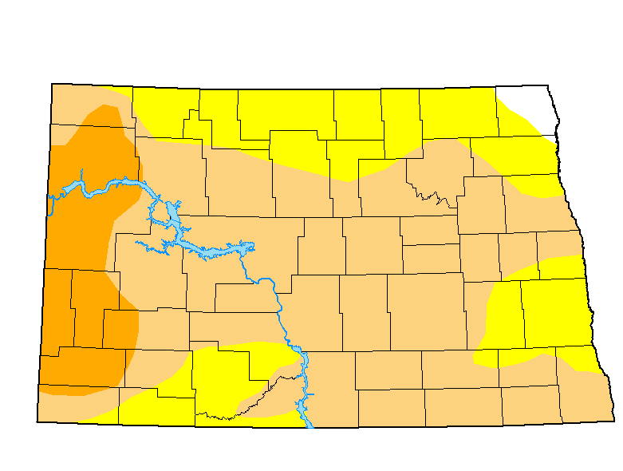
Current conditions
Drought Monitor (NOAA)
Sheyenne River Flows Compared to Historical

Slide 25
Key Operating Plan values for normal operations
Target Summer Elevations
Lake Ashtabula pool elevation 1266.0 +/- 0.2 feet NGVD29
Normal Outflow Targets
Baldhill Dam minimum outflow = 13 cubic feet per second (cfs)
Sheyenne River, downstream channel capacity = 2,400 cfs
Notes:
Corps Employees:
Respond respectfully to all questions
Follow up on questions we cannot answer at this time
Help the public understand project constraints and opportunities
We request that participants:
Respectfully ask questions and share comments
Allow time for all to ask questions and share input
Help the Corps understand opportunities and concerns

Slide 26
Key Operating Plan values for Flood operations
Winter Drawdowns
Lake Ashtabula is drawn down to an elevation of 1262.5 feet every year by March 1 (If a high amount of snow by Jan – target date may be earlier than Mar 1).
Depending on amount of snow pack, the pool can be further drawn down to an elevation of 1257 feet, and if water quality allows 1255 feet before spring snowmelt begins.
Flood Control Pool
During flood events, Lake Ashtabula can be raised up to a level of 1271 feet NGVD29 to reduce flooding impacts downstream.
Notes:
Corps Employees:
Respond respectfully to all questions
Follow up on questions we cannot answer at this time
Help the public understand project constraints and opportunities
We request that participants:
Respectfully ask questions and share comments
Allow time for all to ask questions and share input
Help the Corps understand opportunities and concerns

Slide 27
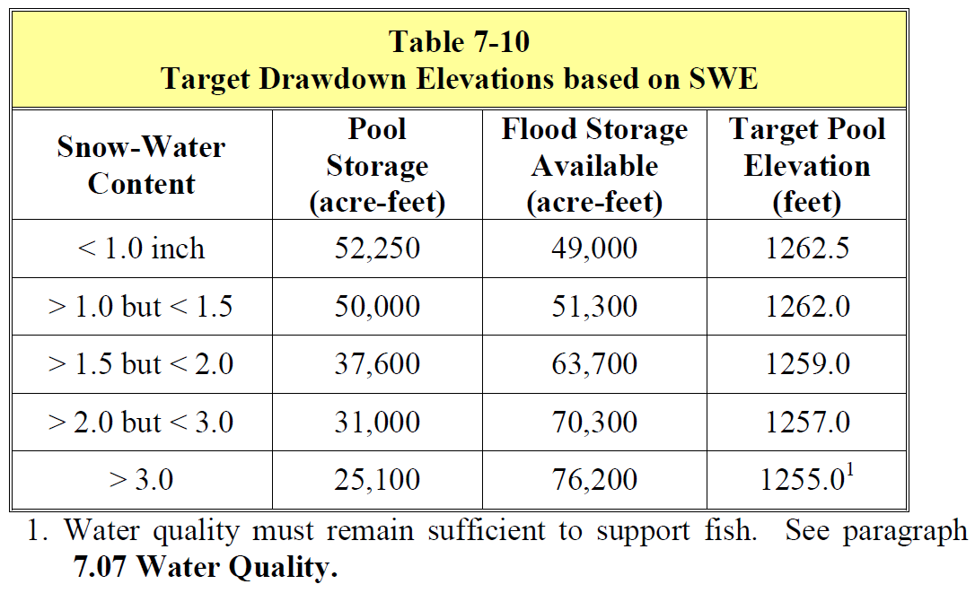
Pre-Melt drawdown Level
Corps 2013 Water Control Manual
BALDHILL DAM AND LAKE ASHTABULA

Slide 28
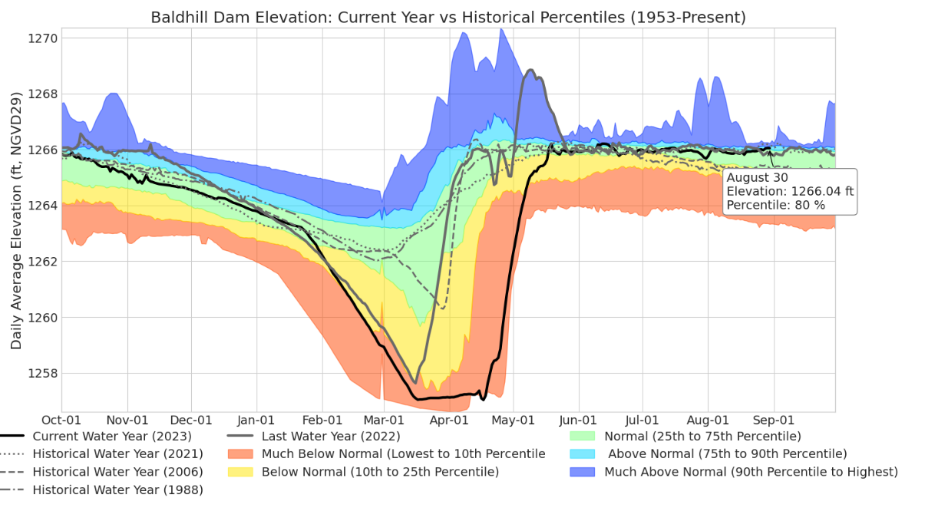
Lake Ashtabula Elevation Duration Hydrograph
Notes:
The top of conservation is typically reached in April/May and the lake.

Slide 29
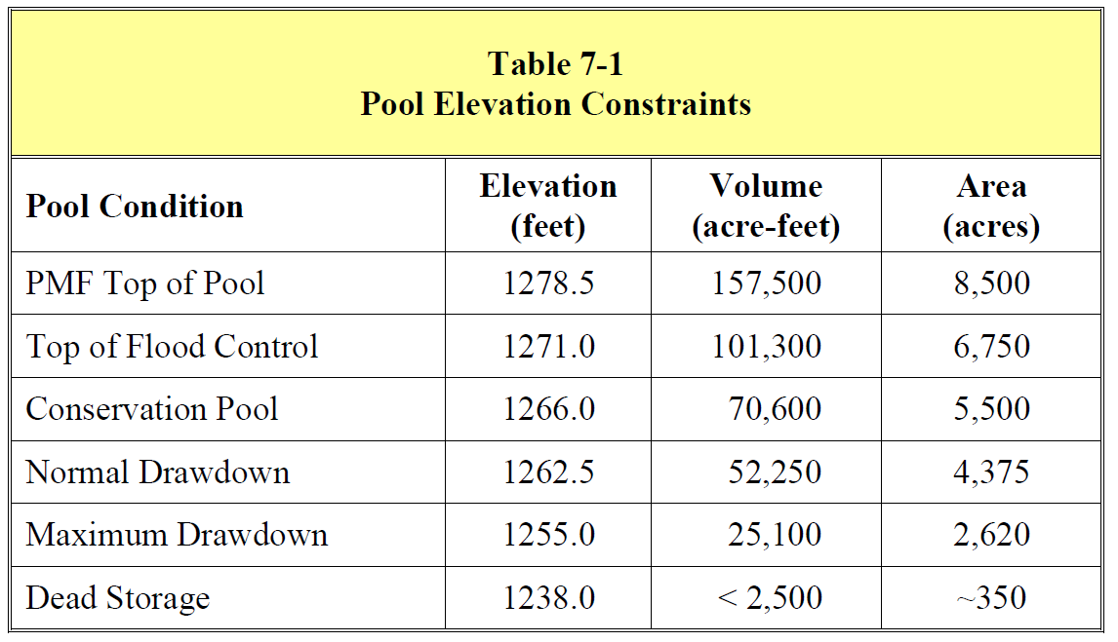
Pool Elevations and Volumes
Corps 2013 Water Control Manual
BALDHILL DAM AND LAKE ASHTABULA

